Slide 1

Making the most out of your Anaesthetics training in Wales
ACCS Induction September 2022
Dr Louise Allman, Training Programme Director

Slide 2
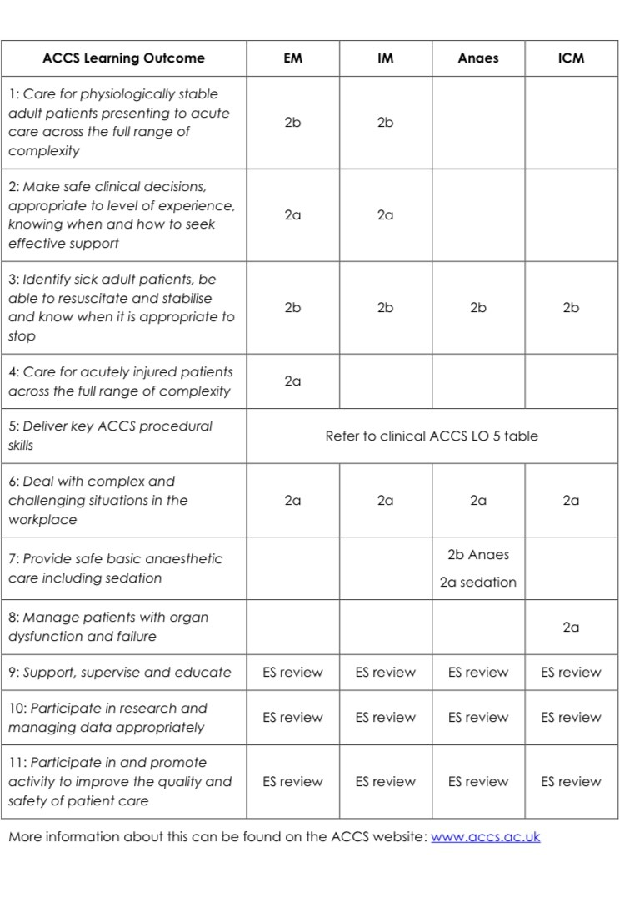

Curriculum summary table

Slide 3
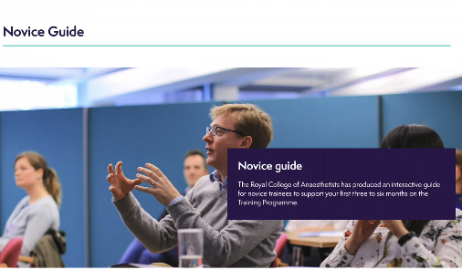
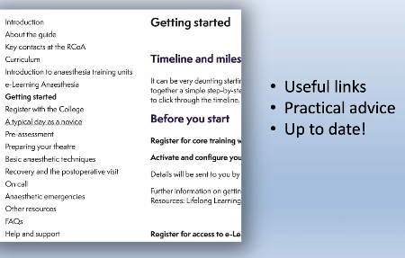
1st things to do
First things to do 1) Register with your parent specialty Royal College (RCoA & LLP) 2) Arrange to meet your CS & your ES
RCoA Novice Guide on RCoA website:

Slide 4
LO7: Provide safe basic anaesthetic care, including sedation
EPA1
EPA2
MTR
IAC Certificate
HALO in SEDATion
6 months is tight, there’s a lot to do! Be informed, be organised.

Slide 5


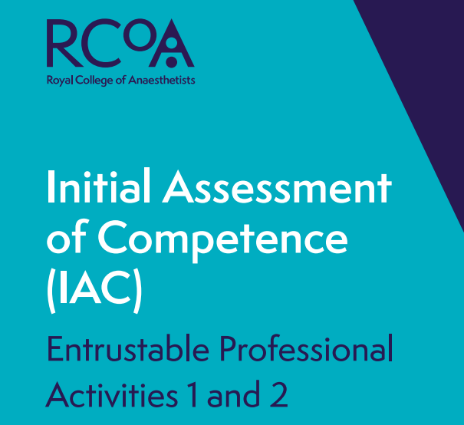
IAC workbook
www.rcoa.ac.uk/sites/default/files/documents/2022-08/EPA-1-1-2022%20v1.1pdf
Aim to complete IAC in 3 months

Slide 6
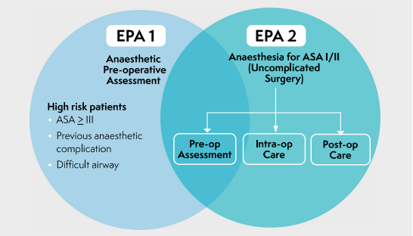
**Each of these to be completed at Entrustment Level of 2b**

Slide 7
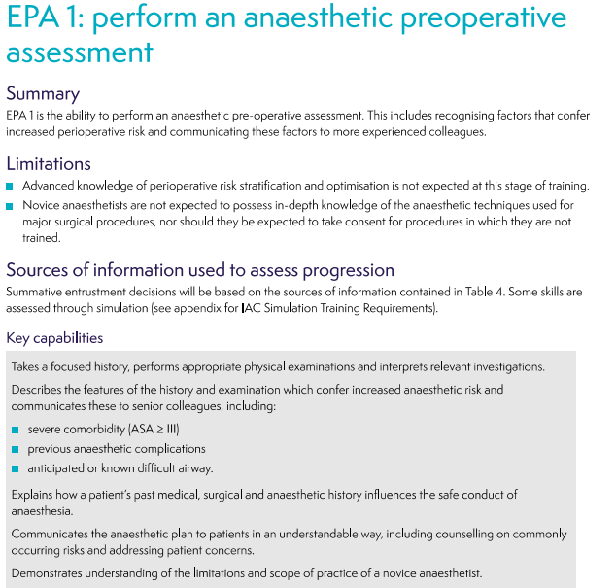

Slide 8
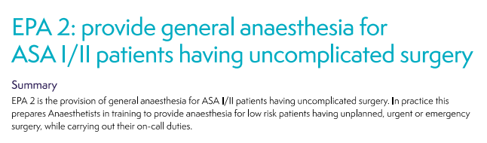

Slide 9
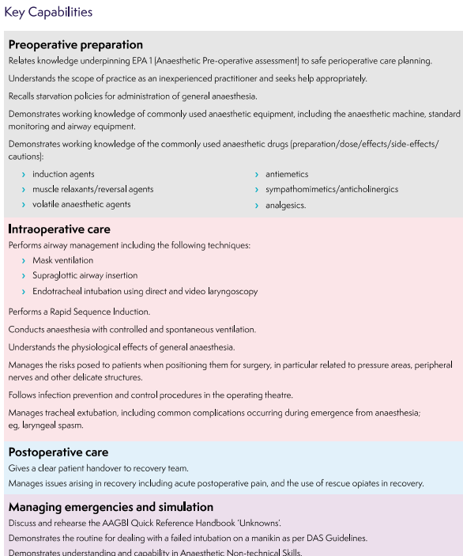
EPA 2

Slide 10
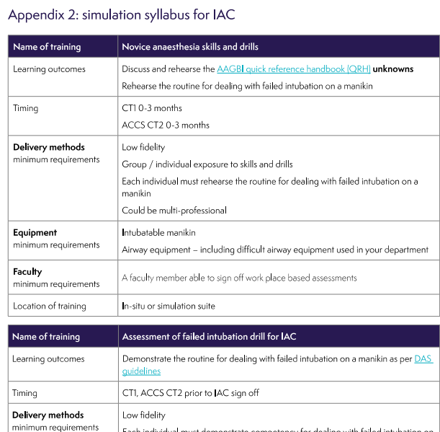
Simulation syllabus for IAC

Slide 11
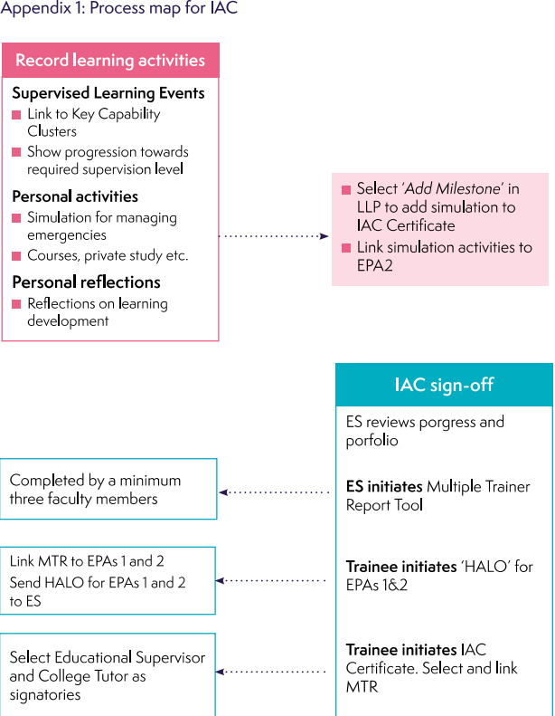

Slide 12
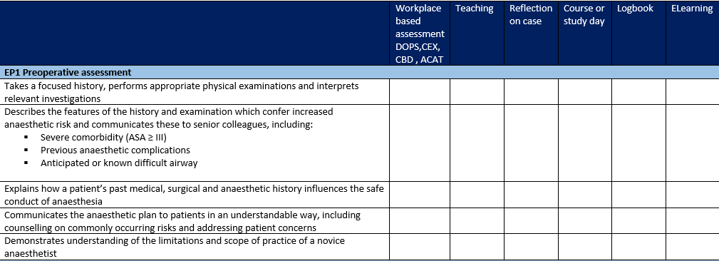
LO7-Crib sheet (table designed by Natalie mincher)

Slide 13
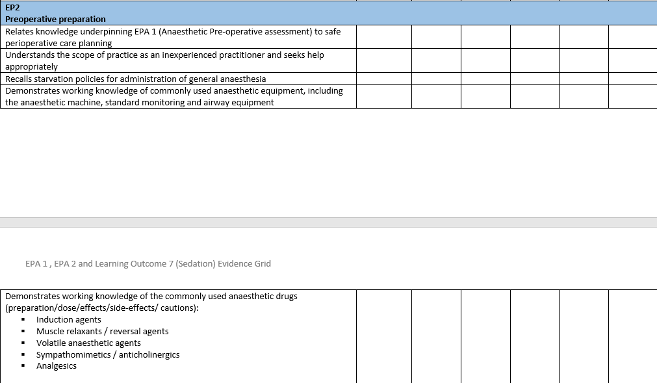

Slide 14
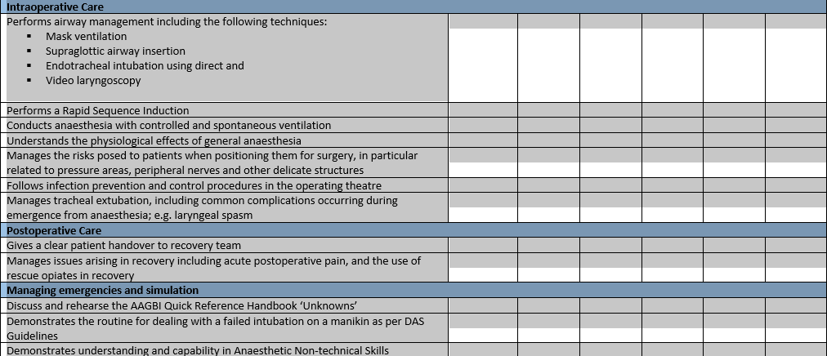

Slide 15
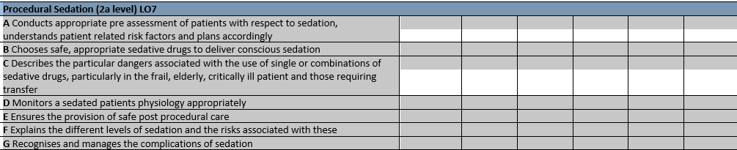
Sedation HALO

Slide 16
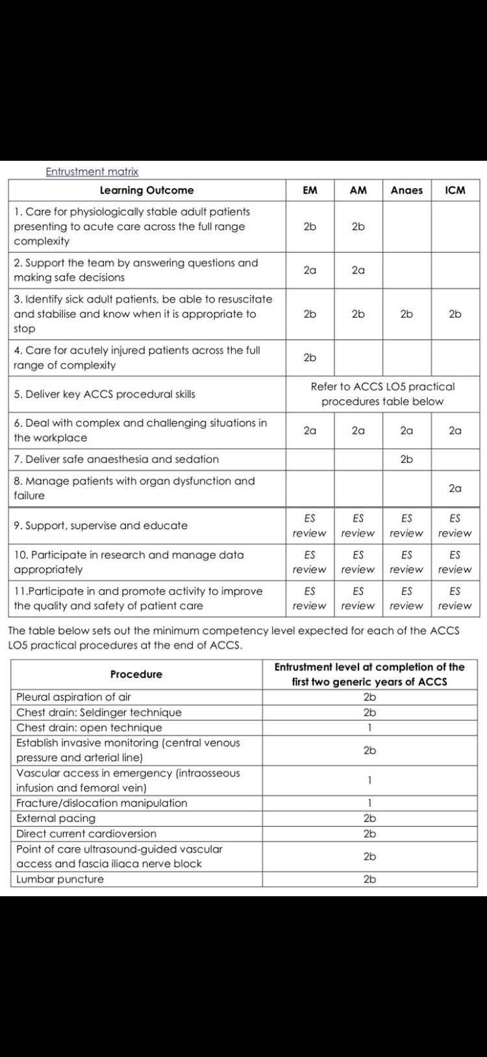

Slide 18
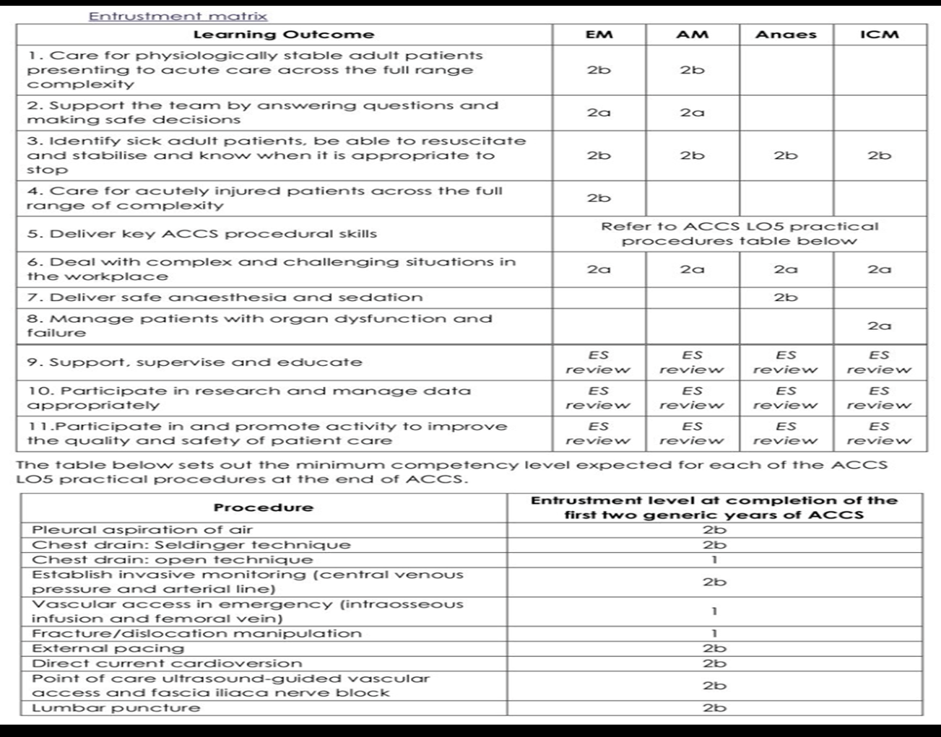

Slide 19
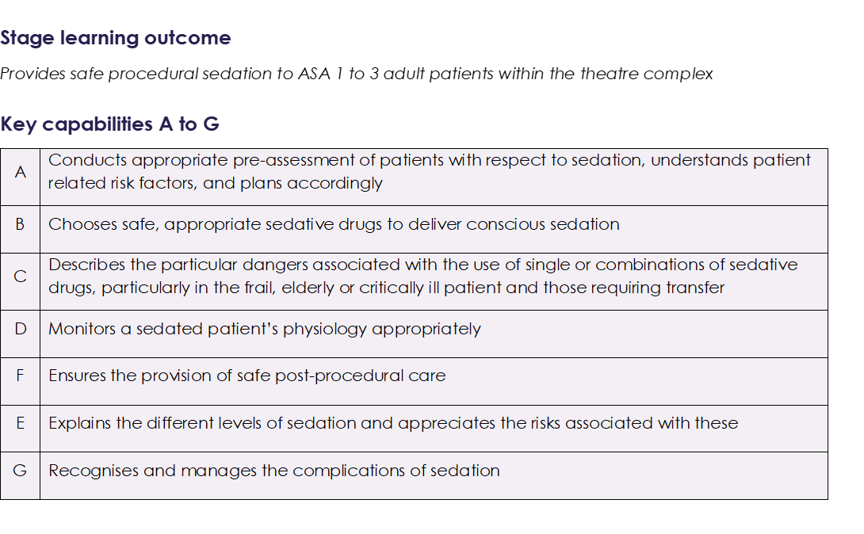
Halo in Procedural sedation
ICACCST specifies this to be achieved/evidenced in the 6 month Anaesthetics placement
Don’t forget about it – initial priority given to EPA 1 & 2, could run out of time
Discuss with Supervisor/ more senior trainees, what sedation experience is available in your department
Keep close eye on experience, and discuss with rota-maker EARLY if need more lists
Required Entrustment Level is 2a.

Slide 20
Ask your supervisors & trainee reps to point out training opportunities in your healthboard
Elective DCCV lists
Sedation lists (dental, endoscopy, bronchoscopy, thorocoscopy, interventional radiology, plus T & O )
REGIONAL ANAESTHESIA TEACHING
JOURNAL CLUBS, QI dept.lead, TO
SIM LAB/ SKILLS LAB
Also: WSoA website (generic curriculum talks, critical incident logbook, US logbook) RCoA website, present at a SAW biannual conference.

Slide 21
EDT
What to expect and when. On/off-site. Timetabled. Flexibility?
Parity with other anaesthetic trainees
Not in novice period, & word of caution
Document aims and objectives with learning needs to address in PDP & agree with Supervisor- what will EDT be used for (e.g. QI project, taking part in formal med.student teaching, careers talk, clinical)
Diarise your EDT, Supervisor will need to r/v and comment in their Supervisor reports/ ESR and whether objectives were met

Slide 22
Useful contacts
Trainee Rep
ACCS hospital Site Lead
Anaesthetic College Tutors:
Cardiff = David Leslie Swansea = Kate Harvey Wrexham = Ruth Vlies ABUHB = Daniel Helme
PCH = Matt Williams (Wales LLP Lead) POW = Paulo Antoniazzi YG = Suman Mitra
ACCS Anaesthetics Lead= Natalie Mincher
TPD = Louise Allman (Consultant Anaesthetist)

Slide 23
What if I don’t complete the LOs?
Share your concerns with your CS & ES early: They will likely have good advice
Talk to me, as an Anaesthetist, and TPD early
Core level trainees are entitled to 6 months training extension (NB total time allowed in core. 6 months in higher training, or 12 months total for run-through) to achieve outstanding competencies or for exam failure: Talk to TPD.
The Professional Support Unit is a fantastic source of support

Slide 24
Some Tips
Be informed: Know your curriculum, know the goals
Keep a logbook: Anaesthetic cases, Sedation cases, US cases and practical procedures
Be organised: Plan your training time, allow for planned (and unplanned) life events.
Aim for at least one WPBA/SLE per training list/day
Be proactive: seek out the consultant you’re rota’d with the next day and ask if you can talk through a particular topic, or be observed pre-assessing a patient.
Ask for feedback and complete assessments on e-portfolio there and then
Be polite & nice to patients and to colleagues, especially the ODPs- they are an invaluable ally!
Arrive in time to see all the patients on your list pre-op, aim to see more than the consultant does!
Allow time to check your anaesthetic machines in theatre & draw up emergency drugs before the start of every list
It’s a steep learning curve, don’t panic! Everyone has had bad days of not getting lines/tubes in first time.
Anaesthesia is part craft, part science: there are many ways of anaesthetising for a certain case: Don’t be disheartened if ‘everybody does it differently’- be receptive, be inquisitive. Most anaesthetists will gladly share their thought process and preferences.

